Slide 1
Serial Communication
Kamalanath Samarakoon

Slide 2
Characteristic Directions
Full duplex
Half duplex
Simplex

Slide 3
Number of devices connected
Point to point
Multidrop

Slide 4
Formats
Synchronous
Asynchronous

Slide 5
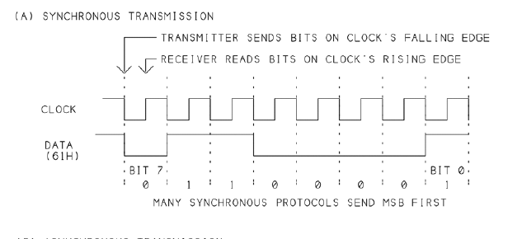
Synchronous communication

Slide 6
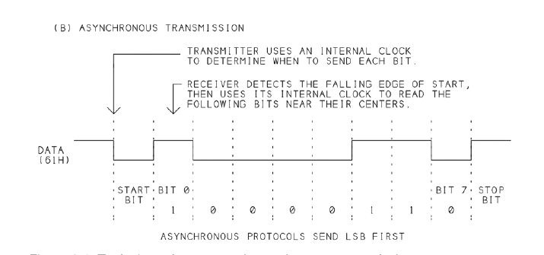
Asynchronous communication
Add parity for error detecting
1 8 N 1 = 8N1
1 7 E 1 = 7E1

Slide 7
Signal
Single ended
Differential

Slide 8
Line termination

Slide 9
Serial communication protocols
Slow
RS 232
RS485
Fast
USB
I²C (IEEE 1384)
FireWire

Slide 10
RS232
Most popular interface before USB
Was available in almost all computer to mainframe
Advantages
Was commonly available
Can do that USB could not
Less number of wires compared to parallel
Inexpensive
Very long cable (50 ft max)/USB 16ft // 10-15 ft
3 wires to communicate (Unlike parallel)

Slide 11
RS232
Disadvantages
Cannot connect more than two devices
Max speed 20,000 bits/s
Very long lines need differential interface (RS485)

Slide 12
RS232 Evolution
Originally
PC to dumb terminal
Then
PC to Internet
Also PC to
Mouse
Printer
Another PC
Microcontroller

Slide 13
RS232
RS (Recommended Standard)
Standard is – EIA 232F (Electronic Industry Association)
This standard defines
Names and functions of signals
Electrical Characteristic of signals
Mechanical standard (size, shape pin assignment)

Slide 14
RS232
25 pins or 9 pins
Logic 0 +3 to +25 V
Logic 1 -3 to -25 V
- 3 to +3 V undefined
O/C V <25 V w.r.t to Ground
S/C I 500mA driver should be able to drive
Max speed 20,000 bps for 50 ft

Slide 15
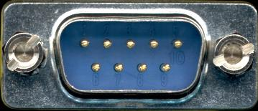
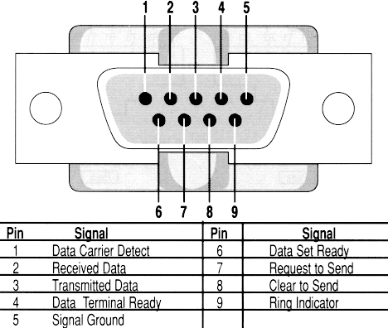
Connectors RS232 – 9 pin
Equipment
Female
Cable
Male

Slide 16
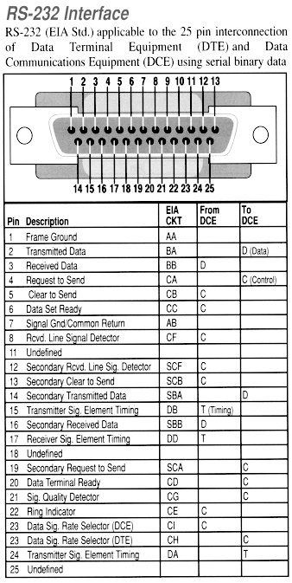

Slide 17
Standard 9 to 25 pin cable layout for async data on a PC AT serial cable
Description | Signal | 9-pin DTE | 25-pin DCE | Source DTE or DCE
Carrier Detect | CD | 1 | 8 | from Modem
Receive Data | RD | 2 | 3 | from Modem
Transmit Data | TD | 3 | 2 | from Terminal/Computer
Data Terminal Ready | DTR | 4 | 20 | from Terminal/Computer
Signal Ground | SG | 5 | 7 | from Modem
Data Set Ready | DSR | 6 | 6 | from Modem
Request to Send | RTS | 7 | 4 | from Terminal/Computer
Clear to Send | CTS | 8 | 5 | from Modem
Ring Indicator | RI | 9 | 22 | from Modem

Slide 18
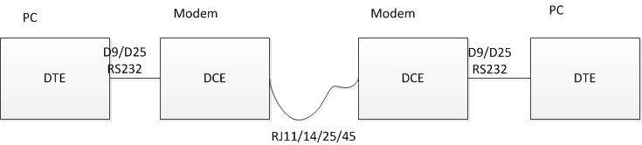
Link
RJ Registered Jack of Universal service ordering code
RJ 11 6 points middle 2 connected
RJ 14 6 points middle 4 connected
RJ 25 6 points middle 6 connected
RJ 45 8 points

Slide 19
Full Name | Function
TD | Transmit Data | Serial Data Output (TXD)
RD | Receive Data | Serial Data Input (RXD)
CTS | Clear to Send | This line indicates that the Modem is ready to exchange data.
DCD | Data Carrier Detect | When the modem detects a "Carrier" from the modem at the other end of the phone line, this Line becomes active.
DSR | Data Set Ready | This tells the UART that the modem is ready to establish a link.
DTR | Data Terminal Ready | This is the opposite to DSR. This tells the Modem that the UART is ready to link.
RTS | Request To Send | This line informs the Modem that the UART is ready to exchange data.
RI | Ring Indicator | Goes active when modem detects a ringing signal from the PSTN.

Slide 20
Null Modem
XX

Slide 21

No Handshake

Slide 22

Full Handshake

Slide 23

Loop back Handshake

Slide 24
USART Universal Asynchronous Receiver/Transmitter
IC Module inside the IC for serial communication
Do parallel in PC to serial in RS232 conversion and back
Supports Half duplex and Full Duplex
Provide all standard RS232 handshaking and control lines

Slide 25
8250 57600 bps
16450 115200 bps
16550 16 Bytes FIFO Buffers
16650 32 Byte FIFO Buffers
16750 64 Byte FIFO Buffers 230,400 bps

Slide 26
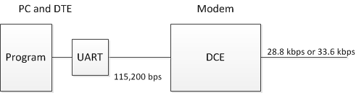
Flow control
Program should set 115,200 kbps and not 33.6 kbps as DCE do compressing
DTE faster than DCE hence data can be lost
Hence use flow control

Slide 27
Flow control
Software
Xoff – Xon
Hardware
Use RTS and DTS lines

Slide 28
Asynchronous communication
Add parity for error detecting
1 8 N 1 = 8N1
1 7 E 1 = 7E1

Slide 29
References
Parallel port, Serial Port and USB
beyondlogic.org
http://retired.beyondlogic.org/spp/parallel.htm
Jan Axelson
Parallel port complete
Serial port complete
USB complete

Slide 30
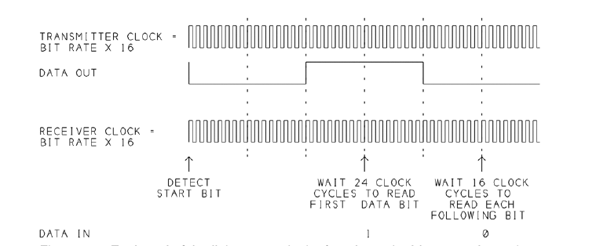
Asynchronous serial communication by USART
UART uses clock that is 16 times bit frequency
E.g. 300 bps 4800 Hz
Detect start bit, wait 8, wait 16, read, wait 16, read…

Slide 31
Calculation of bit rate
In PC UART cock rate is 1.8432 MHz
Calculate maximum bit rate

Slide 32
Quiz
In PC UART cock rate is 1.8432 MHz
Calculate maximum bit rate
If bit rate is 9600bps
How many bytes it can transmit per second?
How many data bytes it can transmit per second when data format is 7E1?
1200 bytes
960 bytes

Slide 33
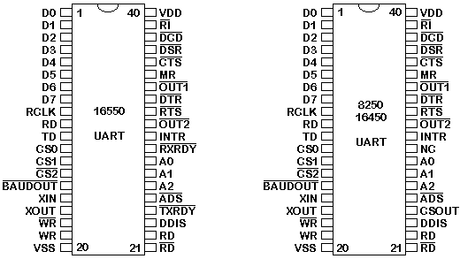
16550 UART
ur homemade devices and projects.

Slide 34
Block diagram
PC Bus side
Data lines
Read and Write control
Interrupt control
Reset
Address Lines
RS232 side
Clock

Slide 35
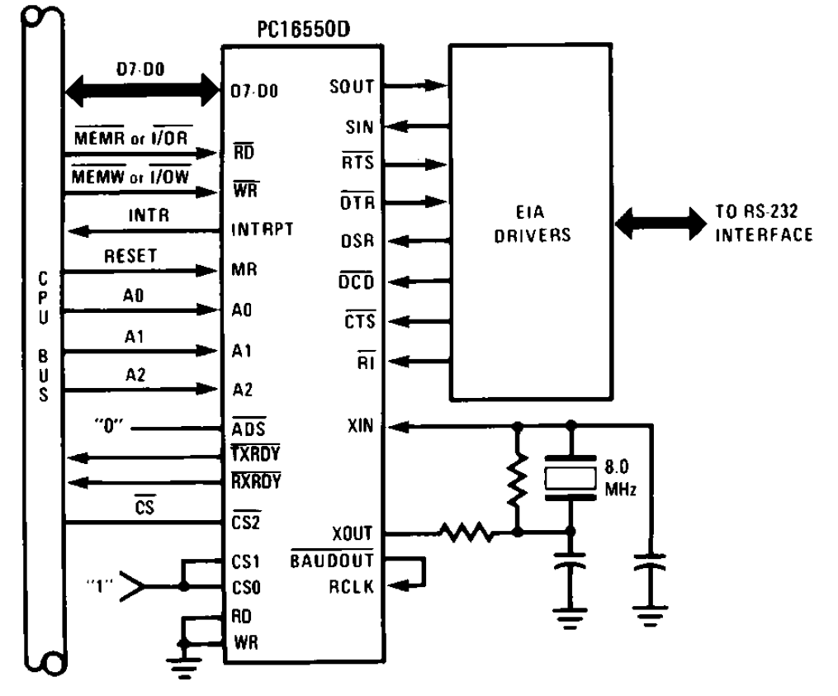
UART

Slide 36
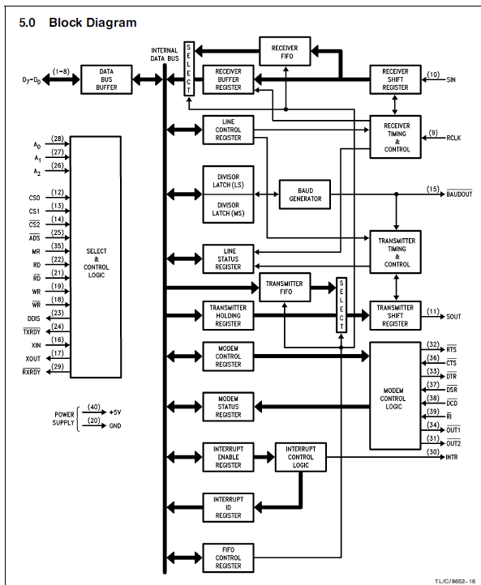

Slide 37
Registers
Addresses = Base +7
12 registers some read and some write and R/W using DLAB (Devisor Latch Access Bit)

Slide 38
Registers
Base Address | DLAB | Read/Write | Abr. | Register Name
+ 0 | =0 | Write | - | Transmitter Holding Buffer
 | =0 | Read | - | Receiver Buffer
 | =1 | Read/Write | - | Divisor Latch Low Byte
+ 1 | =0 | Read/Write | IER | Interrupt Enable Register
 | =1 | Read/Write | - | Divisor Latch High Byte
+ 2 | - | Read | IIR | Interrupt Identification Register
 | - | Write | FCR | FIFO Control Register
+ 3 | - | Read/Write | LCR | Line Control Register
+ 4 | - | Read/Write | MCR | Modem Control Register
+ 5 | - | Read | LSR | Line Status Register
+ 6 | - | Read | MSR | Modem Status Register
+ 7 | - | Read/Write | - | Scratch Register

Slide 39
DLAByte
Speed (BPS) | Divisor (Dec) | Divisor Latch High Byte | Divisor Latch Low Byte
50 | 2304 | 09h | 00h
300 | 384 | 01h | 80h
600 | 192 | 00h | C0h
2400 | 48 | 00h | 30h
4800 | 24 | 00h | 18h
9600 | 12 | 00h | 0Ch
19200 | 6 | 00h | 06h
38400 | 3 | 00h | 03h
57600 | 2 | 00h | 02h
115200 | 1 | 00h | 01h

Slide 40
LCR: Line Control Register
Bit 7 | 1 | Divisor Latch Access Bit
 | 0 | Access to Receiver buffer, Transmitter buffer & Interrupt Enable Register
Bit 6 | Set Break Enable
Bits 3, 4 And 5 | Bit 5 |  | Bit 4 | Bit 3 | Parity Select
 | X |  | X | 0 | No Parity
 | 0 |  | 0 | 1 | Odd Parity
 | 0 |  | 1 | 1 | Even Parity
 | 1 |  | 0 | 1 | High Parity (Sticky)
 | 1 |  | 1 | 1 | Low Parity (Sticky)
Bit 2 | Length of Stop Bit
 | 0 |  | One Stop Bit
 | 1 |  | 2 Stop bits for words of length 6,7 or 8 bits or 1.5 Stop Bits for Word lengths of 5 bits.
Bits 0 And 1 | Bit 1 |  | Bit 0 | Word Length
 | 0 |  | 0 | 5 Bits
 | 0 |  | 1 | 6 Bits
 | 1 |  | 0 | 7 Bits
 | 1 |  | 1 | 8 Bits

Slide 41
MCR: Modem Control Register
Bit | Notes
Bit 7 | Reserved
Bit 6 | Reserved
Bit 5 | Autoflow Control Enabled (16750 only)
Bit 4 | LoopBack Mode
Bit 3 | Aux Output 2
Bit 2 | Aux Output 1
Bit 1 | Force Request to Send
Bit 0 | Force Data Terminal Ready
Notes:
The Modem Control Register is a Read/Write Register. Bits 5,6 and 7 are reserved. Bit 4 activates the loopback mode. In Loopback mode the transmitter serial output is placed into marking state. The receiver serial input is disconnected. The transmitter out is looped back to the receiver in. DSR, CTS, RI & DCD are disconnected. DTR, RTS, OUT1 & OUT2 are connected to the modem control inputs. The modem control output pins are then place in an inactive state. In this mode any data which is placed in the transmitter registers for output is received by the receiver circuitry on the same chip and is available at the receiver buffer. This can be used to test the UARTs operation.
Aux Output 2 maybe connected to external circuitry which controls the UART-CPU interrupt process. Aux Output 1 is normally disconnected, but on some cards is used to switch between a 1.8432MHZ crystal to a 4MHZ crystal which is used for MIDI. Bits 0 and 1 simply control their relevant data lines. For example setting bit 1 to '1' makes the request to send line active.

Slide 42
Modem Status Register
Bit | Notes
Bit 7 | Carrier Detect
Bit 6 | Ring Indicator
Bit 5 | Data Set Ready
Bit 4 | Clear To Send
Bit 3 | Delta Data Carrier Detect
Bit 2 | Trailing Edge Ring Indicator
Bit 1 | Delta Data Set Ready
Bit 0 | Delta Clear to Send

Slide 43
LSR: Line Status Register
Bit | Notes
Bit 7 | Carrier Detect
Bit 6 | Ring Indicator
Bit 5 | Data Set Ready
Bit 4 | Clear To Send
Bit 3 | Delta Data Carrier Detect
Bit 2 | Trailing Edge Ring Indicator
Bit 1 | Delta Data Set Ready
Bit 0 | Delta Clear to Send

Slide 44
IER: Interrupt Enable Register
Bit | Notes
Bit 7 | Reserved
Bit 6 | Reserved
Bit 5 | Enables Low Power Mode (16750)
Bit 4 | Enables Sleep Mode (16750)
Bit 3 | Enable Modem Status Interrupt
Bit 2 | Enable Receiver Line Status Interrupt
Bit 1 | Enable Transmitter Holding Register Empty Interrupt
Bit 0 | Enable Received Data Available Interrupt

Slide 45
IIR: Interrupt Identification Register
Bit | Notes
Bits 6 and 7 | Bit 6 | Bit 7
 | 0 | 0 | No FIFO
 | 0 | 1 | FIFO Enabled but Unusable
 | 1 | 1 | FIFO Enabled
Bit 5 | 64 Byte Fifo Enabled (16750 only)
Bit 4 | Reserved
Bit 3 | 0 | Reserved on 8250, 16450
 | 1 | 16550 Time-out Interrupt Pending
Bits 1 and 2 | Bit 2 | Bit 1
 | 0 | 0 | Modem Status Interrupt
 | 0 | 1 | Transmitter Holding Register Empty Interrupt
 | 1 | 0 | Received Data Available Interrupt
 | 1 | 1 | Receiver Line Status Interrupt
Bit 0 | 0 | Interrupt Pending
 | 1 | No Interrupt Pending
Notes:
The interrupt identification register is a read only register. Bits 6 and 7 give status on the FIFO Buffer. When both bits are '0' no FIFO buffers are active. This should be the only result you will get from a 8250 or 16450. If bit 7 is active but bit 6 is not active then the UART has it's buffers enabled but are unusable. This occurs on the 16550 UART where a bug in the FIFO buffer made the FIFO's unusable. If both bits are '1' then the FIFO buffers are enabled and fully operational.
Bits 4 and 5 are reserved. Bit 3 shows the status of the time-out interrupt on a 16550 or higher.
Lets jump to Bit 0 which shows whether an interrupt has occurred. If an interrupt has occurred it's status will shown by bits 1 and 2. These interrupts work on a priority status. The Line Status Interrupt has the highest Priority, followed by the Data Available Interrupt, then the Transmit Register Empty Interrupt and then the Modem Status Interrupt which has the lowest priority.

Slide 46
Interfacing RS232 to TTL logic levels
RS232

Slide 47
SPECIFICATIONS |  | RS232 | RS423(not wide use) | RS422 | RS485
Mode of Operation |  | SINGLE -ENDED | SINGLE -ENDED | DIFFERENTIAL | DIFFERENTIAL
Total Number of Drivers and Receivers on One Line (One driver active at a time for RS485 networks) |  | 1 DRIVER 1 RECVR | 1 DRIVER 10 RECVR | 1 DRIVER 10 RECVR | 32 DRIVER 32 RECVR
Maximum Cable Length |  | 50 FT. | 4000 FT. | 4000 FT. | 4000 FT.
Maximum Data Rate (40ft. - 4000ft. for RS422/RS485) |  | 20kb/s | 100kb/s | 10Mb/s-100Kb/s | 10Mb/s-100Kb/s
Maximum Driver Output Voltage |  | +/-25V | +/-6V | -0.25V to +6V | -7V to +12V
Driver Output Signal Level (Loaded Min.) | Loaded | +/-5V to +/-15V | +/-3.6V | +/-2.0V | +/-1.5V
Driver Output Signal Level (Unloaded Max) | Unloaded | +/-25V | +/-6V | +/-6V | +/-6V
Driver Load Impedance (Ohms) |  | 3k to 7k | >=450 | 100 | 54
Max. Driver Current in High Z State | Power On | N/A | N/A | N/A | +/-100uA
Max. Driver Current in High Z State | Power Off | +/-6mA @ +/-2v | +/-100uA | +/-100uA | +/-100uA
Slew Rate (Max.) |  | 30V/uS | Adjustable | N/A | N/A
Receiver Input Voltage Range |  | +/-15V | +/-12V | -10V to +10V | -7V to +12V
Receiver Input Sensitivity |  | +/-3V | +/-200mV | +/-200mV | +/-200mV
Receiver Input Resistance (Ohms), (1 Standard Load for RS485) |  | 3k to 7k | 4k min. | 4k min. | >=12k

Slide 48
RS 232 Vs RS485
RS232 Limitations
Speed Distance No of devices
RS232 20 kbps 50-100 ft 1
RS485 10Mbps 4000ft 25
RS232 Dual supply or expensive V convertion
RS485 Single +5V TTL

Slide 49
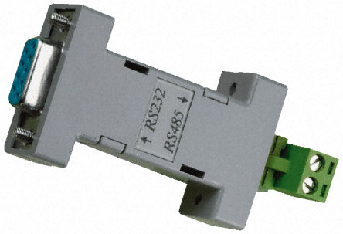
How to get a port USB/RS232 to RS485 converters

Slide 50
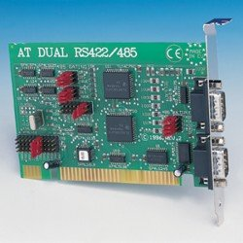
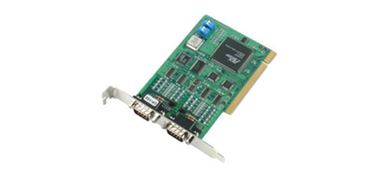
Plug into main bus ISA or PCI

Slide 51
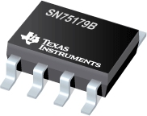
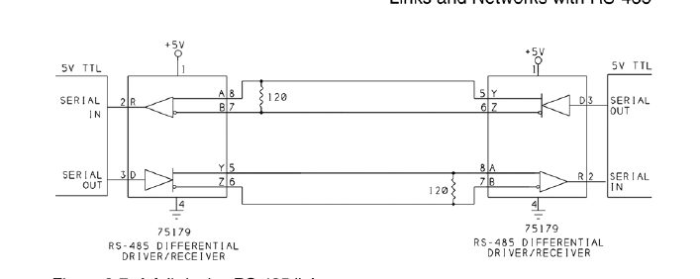
Full Duplex

Slide 52
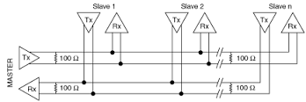
Full duplex multidrop

Slide 53
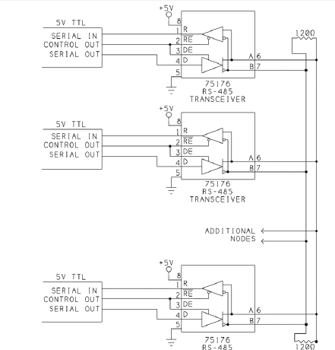
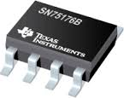
Half Duplex

Slide 54
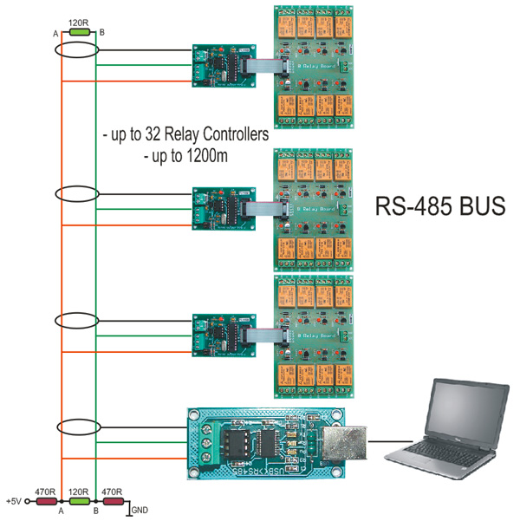

Slide 55
